Slide 1
Linear models
Linear models are everywhere in statistics
Used for:
Comparison/inference
Extrapolation
Prediction

Slide 2
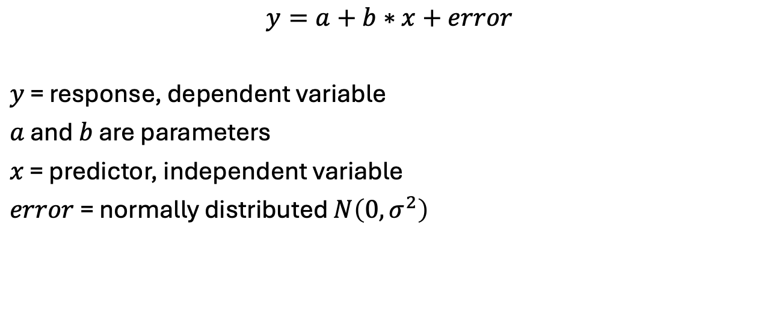
Linear models
$$y=a+b∗x+error$$
$y$ = response, dependent variable
$a$ and $b$ are parameters
$x$ = predictor, independent variable
$error$ = normally distributed $N\left(0,σ^{2}\right)$

Slide 3

Linear models
Can be written in multiple ways:
$$y_{i}=a+b∗x+ε_{i}$$
$$y_{i}∼N\left(a+b∗x_{i},σ^{2}\right)$$
$$y∼N\left(a+b∗x,σ^{2}\right)$$
$$y_{i} ∼N\left(a+\sum_{j=1}^{n_{j}}{x_{i,j}b_{j}},σ^{2}\right)$$
$$y∼N\left(Xβ,σ^{2}I\right)$$
$$response∼a+predictor1+predictor2$$

Slide 4
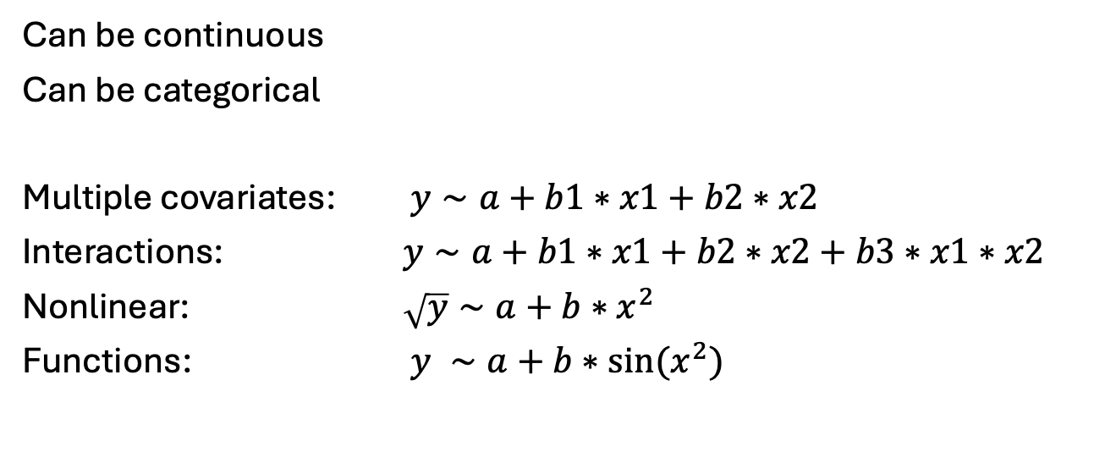
Covariates, predictors, independent variables
Can be continuous
Can be categorical
Multiple covariates: $y∼a+b1∗x1+b2∗x2$
Interactions: $y∼a+b1∗x1+b2∗x2+b3∗x1∗x2$
Nonlinear: $\sqrt{y}∼a+b∗x^{2}$
Functions: $y ∼a+b∗sin⁡(x^{2})$

Slide 5
Approach 1 – Use existing R functions
Step 1 – Find function
For linear model, use lm in the base package
Step 2 – Apply function
Usually easy in R
Step 3 – Extract information from object
Often hard
Sometimes use summary or attributes commands

Slide 6
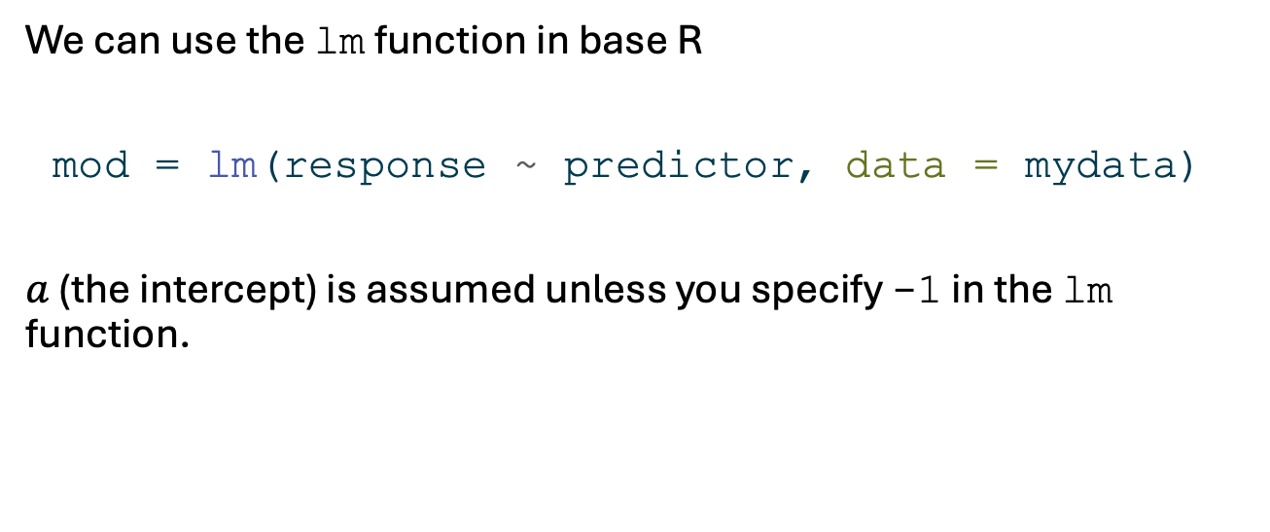
Linear models In R (1)
We can use the lm function in base R
mod = lm(response ~ predictor, data = mydata)
$a$ (the intercept) is assumed unless you specify -1 in the lm function.

Slide 7

Fitting a regression and displaying results (1)
$$y∼x$$
$$y∼a+b∗x$$
n <- 40 x <- runif(n, 0, 20) y <- 0.2 + 0.3 * x + rnorm(n, mean = 0, sd = 0.5) mod <- lm(y ~ x)

Slide 8
Using summary(mod)
Call: lm(formula = y ~ x) Residuals: Min 1Q Median 3Q Max -0.98035 -0.31250 -0.00744 0.31776 1.12977 Coefficients: Estimate Std. Error t value Pr(>|t|) (Intercept) 0.03300 0.14081 0.234 0.816 x 0.31716 0.01369 23.167 <2e-16 *** --- Signif. codes: 0 '***' 0.001 '**' 0.01 '*' 0.05 '.' 0.1 ' ' 1 Residual standard error: 0.4997 on 38 degrees of freedom Multiple R-squared: 0.9339, Adjusted R-squared: 0.9321 F-statistic: 536.7 on 1 and 38 DF, p-value: < 2.2e-16

Slide 9
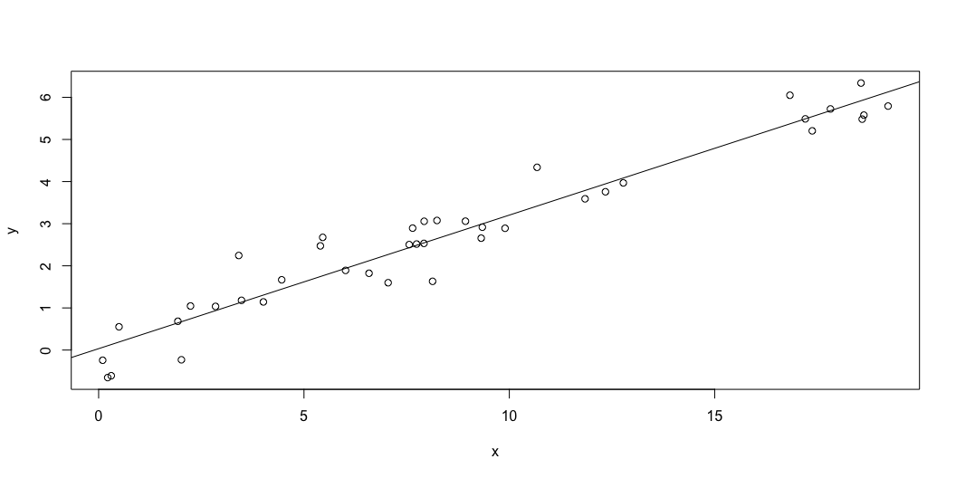
Fitting a regression and displaying results (2)
plot(x, y) abline(mod)

Slide 10
Approach 2 – Write custom R functions
Step 1 – Write function
Step 2 – Fit function
nlminb or optim
Step 3 – Extract information from object
Often hard
Write custom code

Slide 11
Linear models in R (2)
We can also specify out own function
lm_fun <- function(pars, y, x){ alpha <- pars[1] beta <- pars[2] sigma <- exp(pars[3]) # Exp to keep positive nll = -sum(dnorm(y, alpha + beta * x, sigma, log = TRUE )) return(nll) } fit <- nlminb(start = c(1,2,1), lm_fun, y = y), x = x)

Slide 12
Linear models in R: Smart way (2)
lm_fun <- function(pars, y, x){ beta <- pars[1:ncol(x)] sigma <- exp(pars[ncol(x) + 1]) # Exp to keep positive nll = -sum(dnorm(y, x %*% beta, sigma, log = TRUE)) return(nll) } x_mat <- model.matrix(formula(~ 1 + x)) fit <- optim(par = c(0,0,0), lm_fun, y = y, x = x_mat, hessian = TRUE)

Slide 13
Linear models in RTMB
library(RTMB) f <- function(parms) { y <- data$y x <- data$x a <- parms$a b <- parms$b logSigma <- parms$logSigma ADREPORT(exp(2*logSigma)); nll = -sum(dnorm(y, a+b*x, exp(logSigma), TRUE)) nll }

Slide 14
data <- list(y = y, x = x) parameters <- list(a=0, b=0, logSigma=0) obj <- MakeADFun(f, parameters, silent = TRUE) obj$hessian <- TRUE opt <- do.call("optim", obj) # opt # opt$hessian ## <-- FD hessian from optim # obj$he() ## <-- Analytical hessian rep <- sdreport(obj) summary(rep)
Estimate Std. Error a 0.2835332 0.17143875 b 0.2936191 0.01587871 logSigma -0.7145883 0.11180755 exp(2 * logSigma) 0.2395061 0.05355717

Slide 15

Comparison of two groups (1)
$$y∼group$$
$$y∼a+b∗group$$
group <- rep(c(0, 1), each = n/2) y <- 0.2 + 2 * group + rnorm(n, mean = 0, sd = 0.5) mod <- lm(y ~ as.factor(group))

Slide 16
summary(mod)
Call: lm(formula = y ~ as.factor(group)) Residuals: Min 1Q Median 3Q Max -1.16095 -0.31790 -0.02895 0.35071 1.23980 Coefficients: Estimate Std. Error t value Pr(>|t|) (Intercept) 0.3379 0.1344 2.515 0.0163 * as.factor(group)1 1.7957 0.1901 9.448 1.61e-11 *** --- Signif. codes: 0 '***' 0.001 '**' 0.01 '*' 0.05 '.' 0.1 ' ' 1 Residual standard error: 0.601 on 38 degrees of freedom Multiple R-squared: 0.7014, Adjusted R-squared: 0.6936 F-statistic: 89.27 on 1 and 38 DF, p-value: 1.613e-11

Slide 17
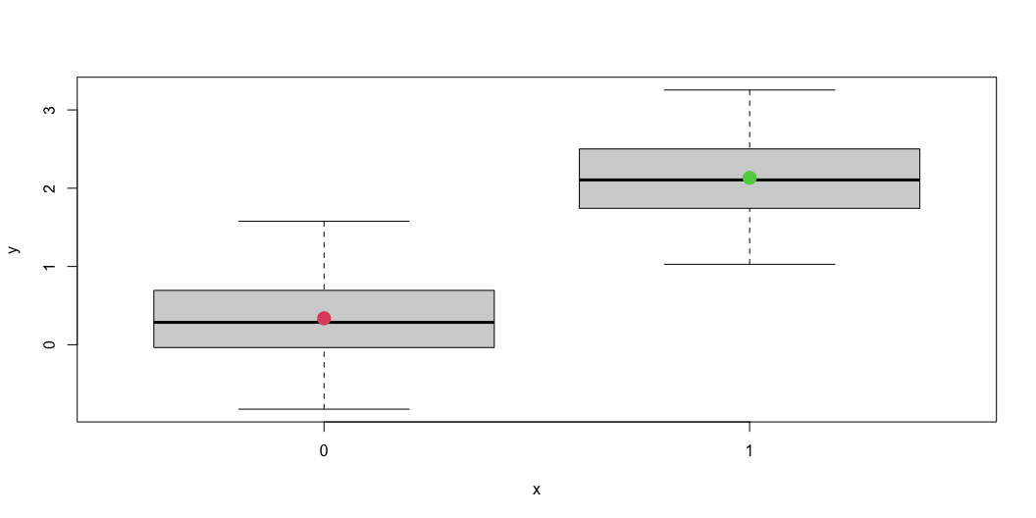
Comparison of two groups (2)
plot(as.factor(group), y) # Model mean_val <- c(mod$coefficients[1], mod$coefficients[1]+ mod$coefficients[2])
points(as.factor(c(0,1)), mean_val, pch = 16, col = c(2,3), cex = 2)

Slide 18
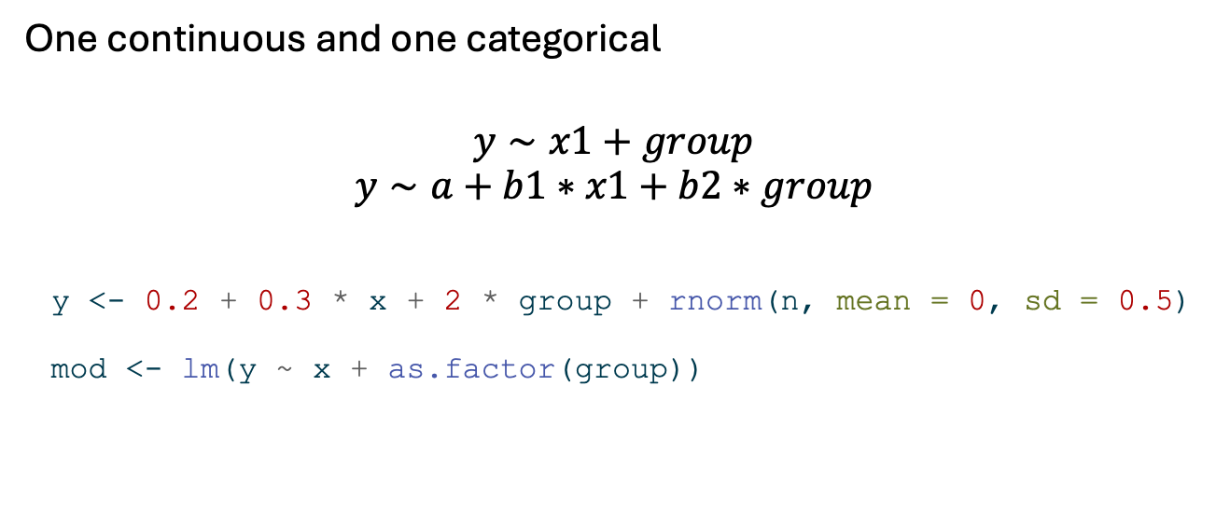
Multiple predictors (1)
One continuous and one categorical
$$y∼x1+group$$
$$y∼a+b1∗x1+b2∗group$$
y <- 0.2 + 0.3 * x + 2 * group + rnorm(n, mean = 0, sd = 0.5) mod <- lm(y ~ x + as.factor(group))

Slide 19
summary(mod)
Call: lm(formula = y ~ x + as.factor(group)) Residuals: Min 1Q Median 3Q Max -1.05967 -0.34604 -0.09237 0.34883 1.44022 Coefficients: Estimate Std. Error t value Pr(>|t|) (Intercept) 0.25363 0.18028 1.407 0.168 x 0.27277 0.01539 17.728 < 2e-16 *** as.factor(group)1 2.13210 0.17760 12.005 2.52e-14 *** --- Signif. codes: 0 '***' 0.001 '**' 0.01 '*' 0.05 '.' 0.1 ' ' 1 Residual standard error: 0.5615 on 37 degrees of freedom Multiple R-squared: 0.9265, Adjusted R-squared: 0.9225 F-statistic: 233.2 on 2 and 37 DF, p-value: < 2.2e-16

Slide 20
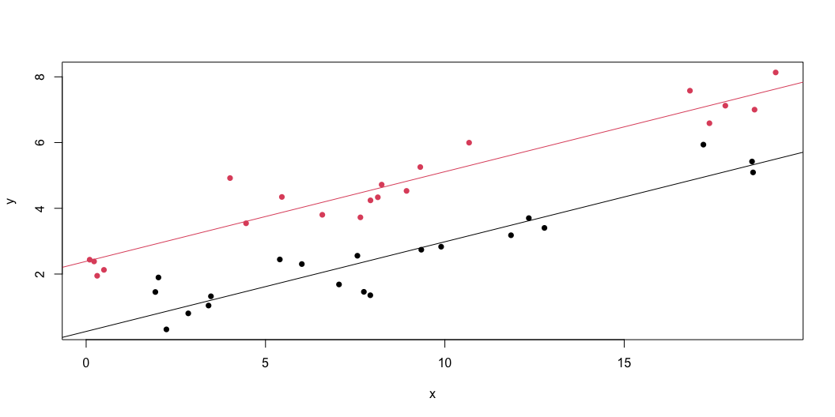
Multiple predictors (2)
plot(x, y, col = 1 + group, pch = 16) # Fitted model abline(a = mod$coefficients[1], b = mod$coefficients[2]) abline(a = mod$coefficients[1] + mod$coefficients[3], b = mod$coefficients[2], col = 2)

Slide 21
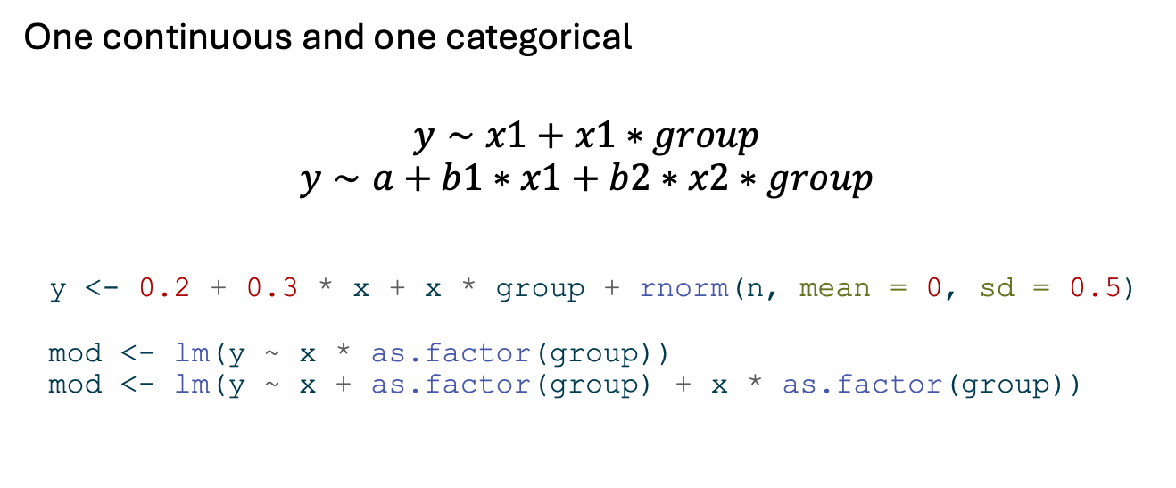
Interaction (1)
One continuous and one categorical
$$y∼x1+x1∗group$$
$$y∼a+b1∗x1+b2∗x2∗group$$
y <- 0.2 + 0.3 * x + x * group + rnorm(n, mean = 0, sd = 0.5) mod <- lm(y ~ x * as.factor(group)) mod <- lm(y ~ x + as.factor(group) + x * as.factor(group))

Slide 22
summary(mod) and no group effect!
Call: lm(formula = y ~ x + as.factor(group) + x * as.factor(group)) Residuals: Min 1Q Median 3Q Max -1.07246 -0.37430 0.00069 0.48121 1.05441 Coefficients: Estimate Std. Error t value Pr(>|t|) (Intercept) 0.35676 0.23759 1.502 0.142 x 0.29673 0.02396 12.385 1.53e-14 *** as.factor(group)1 -0.28214 0.32028 -0.881 0.384 x:as.factor(group)1 1.02476 0.03133 32.712 < 2e-16 *** --- Signif. codes: 0 '***' 0.001 '**' 0.01 '*' 0.05 '.' 0.1 ' ' 1 Residual standard error: 0.5633 on 36 degrees of freedom Multiple R-squared: 0.9947, Adjusted R-squared: 0.9943 F-statistic: 2259 on 3 and 36 DF, p-value: < 2.2e-16

Slide 23
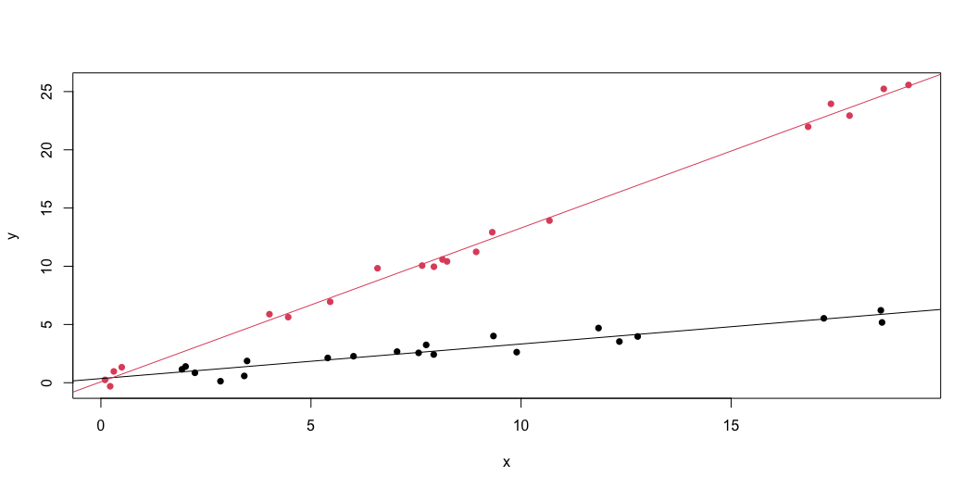
Interaction (2): Simulated data
plot(x, y, col = 1 + group, pch = 16) # Fitted model abline(a = mod$coefficients[1], b = mod$coefficients[2]) abline(a = mod$coefficients[1]+mod$coefficients[3],
b = mod$coefficients[2] + +mod$coefficients[4], col = 2)

Slide 24
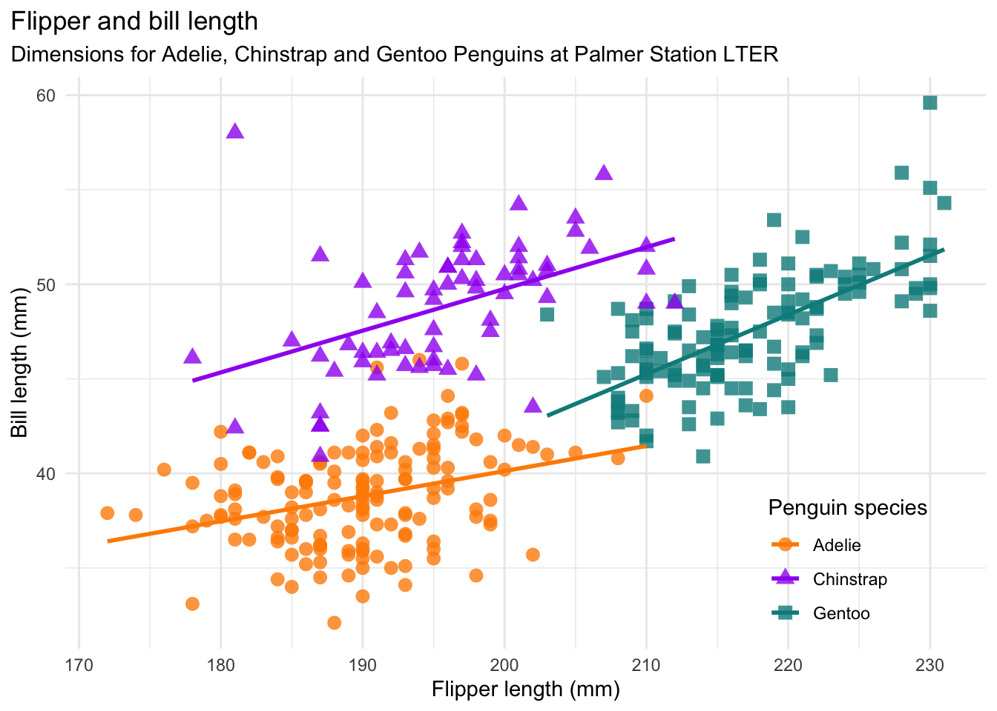
Interaction (3): Observed data
https://allisonhorst.github.io/palmerpenguins/

Slide 25
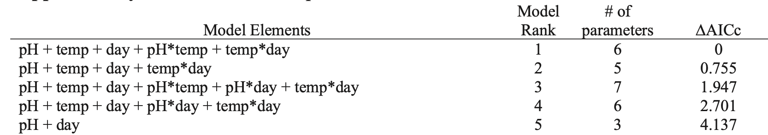
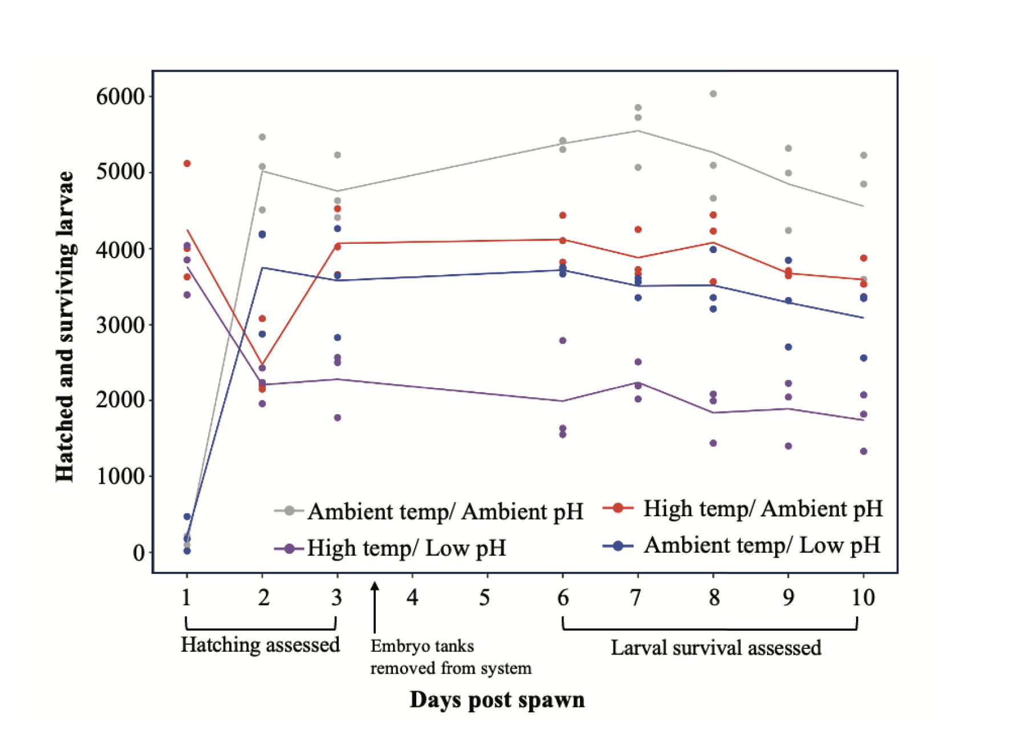
Interaction (4): Experiment
Bates 2024

Slide 26

Multiple continuous predictors (1)
$$y∼x1+x2$$
$$y∼a+b1∗x1+b2∗x2$$
x1 <- runif(n, 0, 20) x2 <- runif(n, 5, 10) y <- 0.2 + 0.3 * x1 + 2 * x2 + rnorm(n, mean = 0, sd = 0.5) mod <- lm(y ~ x1 + x2)

Slide 27
summary(mod)
Call: lm(formula = y ~ x1 + x2) Residuals: Min 1Q Median 3Q Max -0.62466 -0.35368 -0.04125 0.18806 1.04054 Coefficients: Estimate Std. Error t value Pr(>|t|) (Intercept) 0.17750 0.43792 0.405 0.688 x1 0.28859 0.01147 25.150 <2e-16 *** x2 2.01748 0.05007 40.297 <2e-16 *** --- Signif. codes: 0 '***' 0.001 '**' 0.01 '*' 0.05 '.' 0.1 ' ' 1 Residual standard error: 0.4251 on 37 degrees of freedom Multiple R-squared: 0.9817, Adjusted R-squared: 0.9808 F-statistic: 994.6 on 2 and 37 DF, p-value: < 2.2e-16

Slide 28
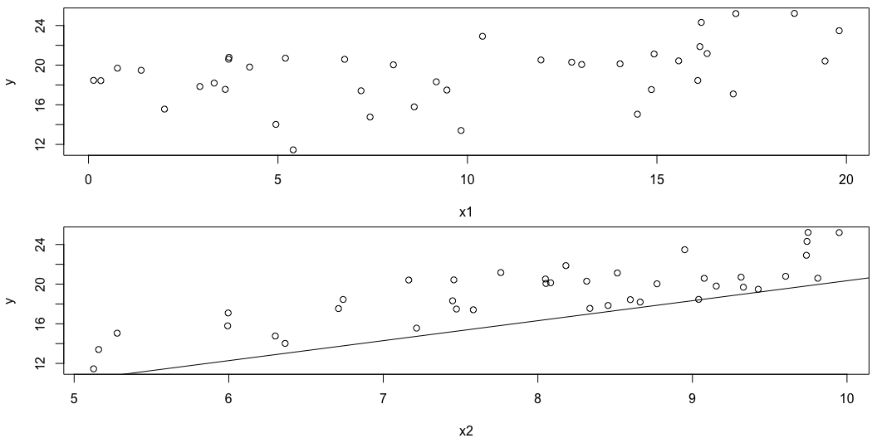
Multiple continuous predictors (2)
par(mfrow = c(2, 1), mar = c(4, 4, 0.5, 0.5)) plot(x1, y) abline(a = mod$coefficients[1], b = mod$coefficients[2]) plot(x2, y) abline(a = mod$coefficients[1], b = mod$coefficients[3])

Slide 29
Multiple continuous predictors (3)
What went wrong?

Slide 30
Multiple continuous predictors (4)
Have to fix covariates at arbitrary values!

Slide 31
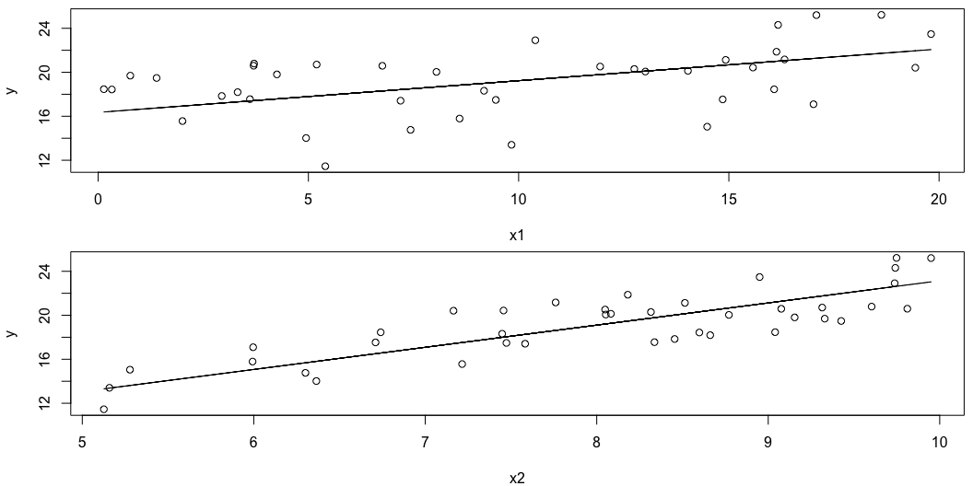
Multiple continuous predictors (4)
par(mfrow = c(2, 1), mar = c(4, 4, 0.5, 0.5)) plot(x1, y) pred1 <- data.frame(x1 = x1, x2 = mean(x2)) pred1$y = predict(mod, pred1) lines(pred1$x1, pred1$y) plot(x2, y) pred2 <- data.frame(x1 = mean(x1), x2 = x2) pred2$y = predict(mod, pred2) lines(pred2$x2, pred2$y)

Slide 32
Scale covariates to make them comparable
scale(x1)# Mismo que(x1 – mean(x1))/sd(x1)
scale(x2)
Y ahora x1 y x2 van a tener el miso promedio (0) y standard deviation (1)
Pero cuidado con prediction, porque tendrian que tener el mismo transformation
X2_pred = scale(x2_pred)
X2_pred = (x2_pred – mean(x2))/sd(x2)

Slide 33
Multiple predictors overview
It can be hard to visualize models with multiple predictors!
Packages like marginaleffects can help

